Slide 1

EPGD PML Project Learning to Label – From Clustering to Classification
Sanjeev Ranjan
Shreyas Shanbhag
Kunal Sant

Slide 2
Index
Learning to Label – From Clustering to Classification
Executive Summary
Text Processing
Introduction & Data Set
Dataset Partition and Preprocessing
EDA
Vectorization & PCA
Clustering
Training the classifier and conclusion
Challenges , Learning & Conclusion
Image Processing
Introduction and Data Set
EDA
Different Approaches ( Clustering + Classification )
Challenges , Learning & Conclusion
References

Slide 3
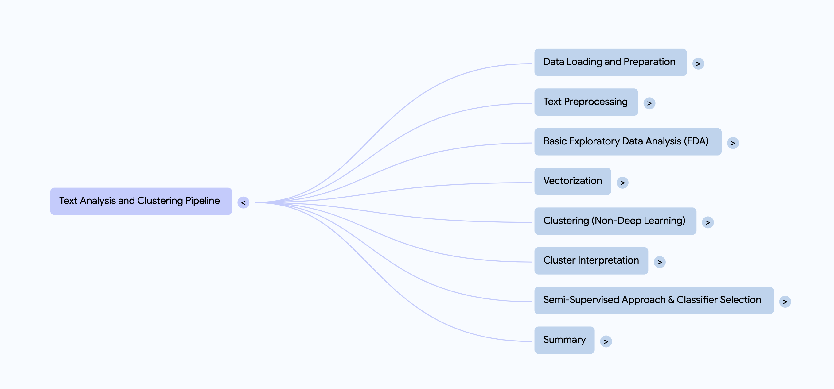
Executive Summary
Text Processing
Problem Overview: Performing clustering to classification on a corpus of documents where each document belongs to one of the 5 topics . Documents are unlabeled raw text.
Approach :
Our approach includes Data Preprocessing , EDA , Vectorization , Clustering & finally training a classifier on the cluster Labels . The below mind map gives a graphical representation of our approach .

Slide 4
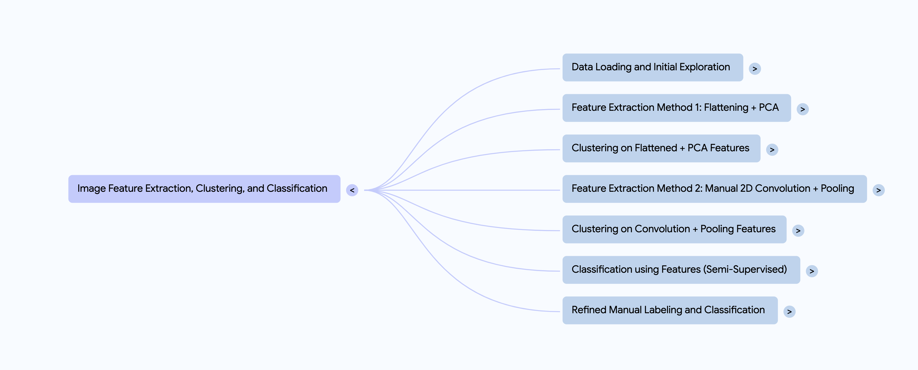
Executive Summary
Image Processing
Problem Overview: Performing clustering to classification on handwritten digits from MNIST data which are unlabeled .
Approach :
Our approach to image analysis involves feature extraction using convolution and PCA , feature enhancement using pooling , clustering of features and semi-supervised classification using techniques like Logistic Regression as illustrated in the below mind map .

Slide 5
Executive Summary
 | Text Processing | Image Processing
Key Findings | KMeans clustering, particularly with Word2Vec embeddings, provided a clear structure, with internal metrics like Silhouette, Davies-Bouldin etc Evaluation of classifiers trained to predict these clusters showed promising results, demonstrating that the cluster structure can be effectively captured by supervised models | Flattened image data & PCA proved ineffective for digit class clustering due to lost spatial info . While dimensionality was reduced, visual grouping based on class was unsuccessful. Manual 2D convolution features provided a much better basis for grouping visually similar images.
Major Conclusion | The clustering approach successfully identified potential latent groupings in the document collection, providing valuable insights into the diverse content present. Training a classifier based on the cluster assignments derived from the training data proves viable as can be seen from the results of classifiers such as SVM, Logistic Regression ,Random Forest etc. | The clustering approach successfully established baseline performance through classification using both manual and cluster-derived pseudo labels . Explored unsupervised feature extraction using manual 2D convolutions & PCA, followed by KMeans clustering on the resulting features.

Slide 6
Text Processing

Slide 7
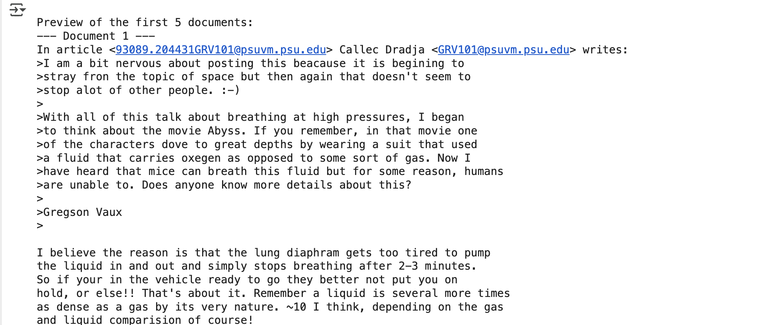
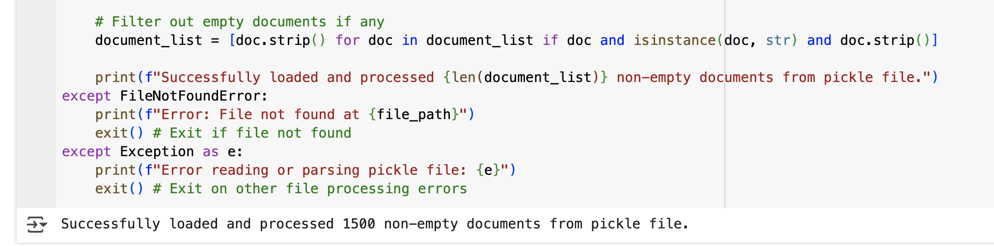
Introduction & Data Set
Snap of Data
Text Data Set | Snap Of Data
Observations : Text Data Set (train_data_text.pkl) After pre-processing , there is no loss of data observed The total size of the data is 1500 paragraphs .

Slide 8
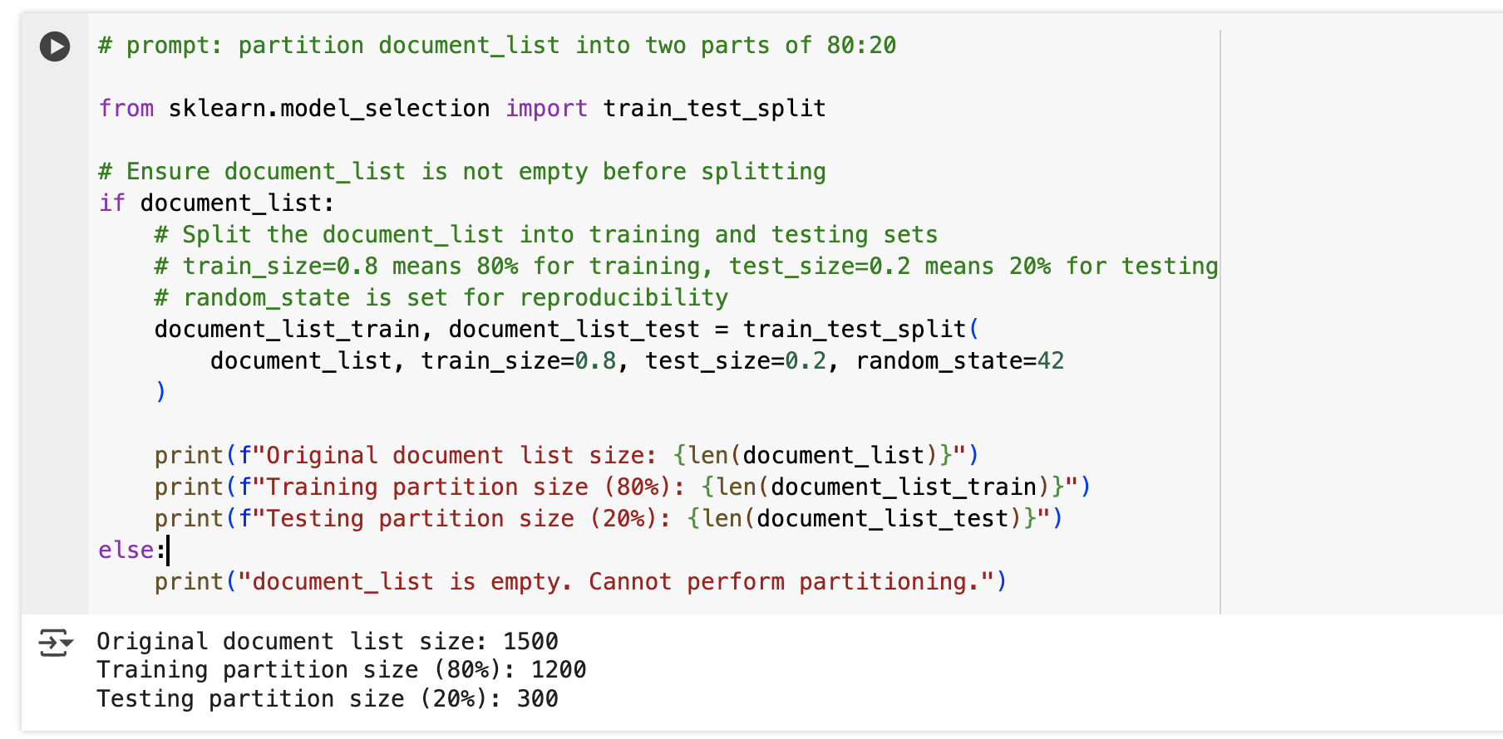
Data Partitioning
Post data import, the dataset was strategically partitioned to facilitate robust model training and evaluation.
A standard 80/20 split was employed, allocating 80% of data for training and 20% for testing, adhering to common practice.
The train_test_split function from sklearn.model_selection was utilized for precise and reproducible data partitioning.
Resulting datasets were clearly designated as document_list_train and document_list_test for subsequent processing steps.

Slide 9
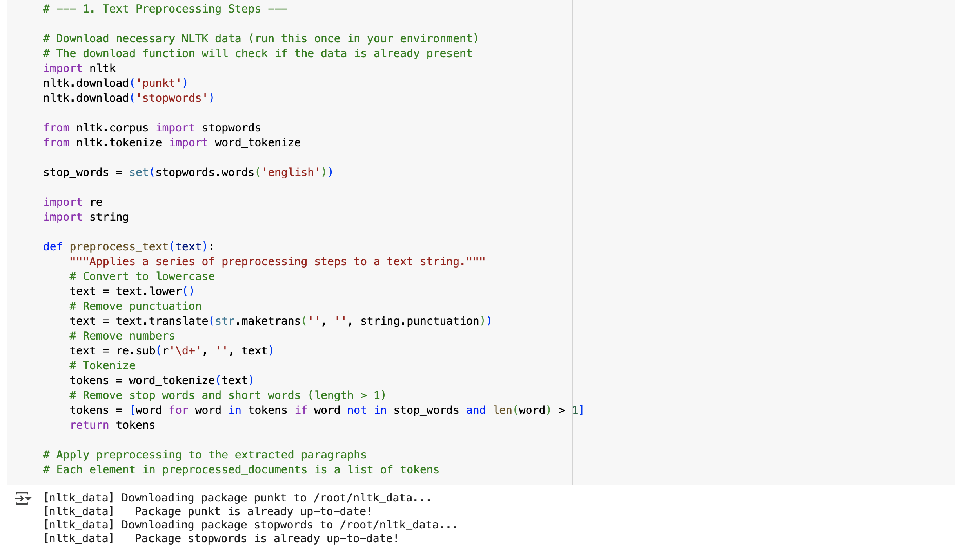
Data Preprocessing
For data preprocessing inbuilt python packages such as nltk, re and string are used.
The general steps followed for preprocessing involve:- text cleaning, stopword removal, tokenization, normalization(stemming and lemmatization), vocabulary construction and word embedding.
All further analysis is performed on the document_list_train dataset.

Slide 10
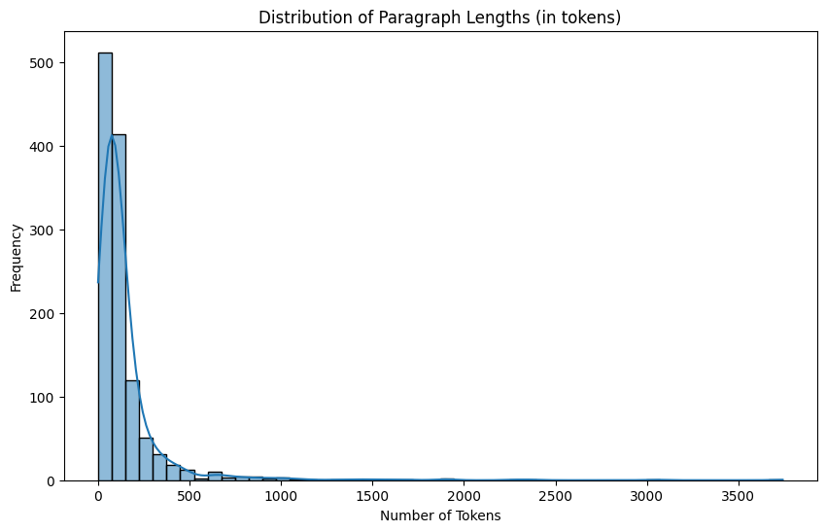
Exploratory Data Analysis (EDA)
Paragraph Length Analysis: EDA involves analysis of paragraph lengths (token counts) within the pre-processed training documents to understand content structure.
Key Word Identification: Word frequency distributions were analysed, highlighting the top 50 most frequent terms in the training corpus.
Token Range: The analysis identified a significant range in document tokens , spanning from a concise single token to an extensive 3,742 tokens.
Token Distribution : Visualization of paragraph lengths revealed a positive skew, indicating that the majority of documents are concise (predominantly 0-500 tokens), with fewer lengthy texts, as is characteristic of many datasets.
The average paragraph length is given by
144.43 tokens
The median paragraph length is 86 tokens.

Slide 11
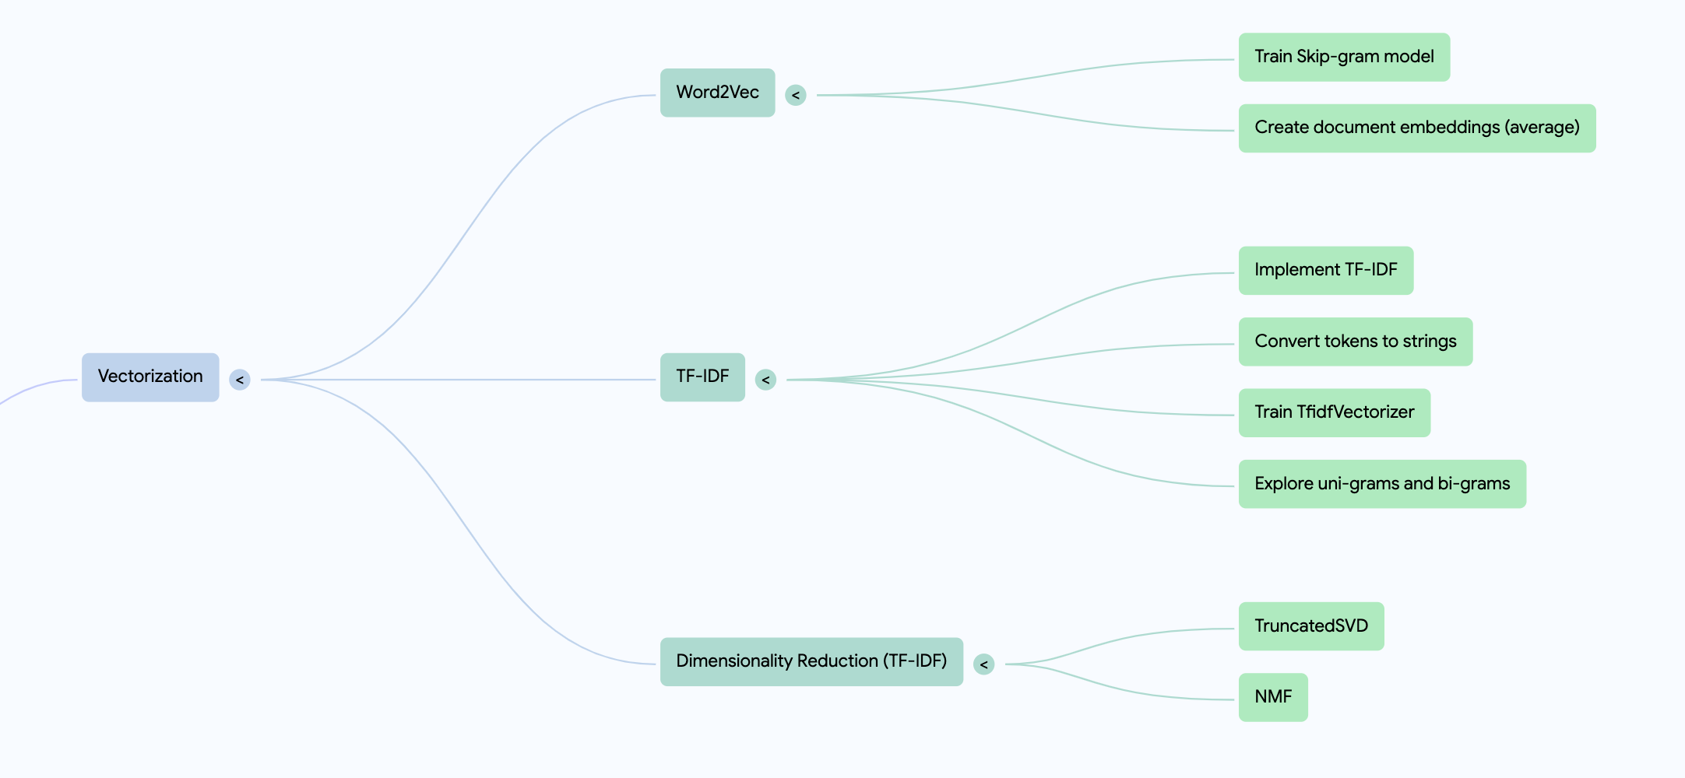
Vectorization
The vectorization is done using word2vec as it is maps the words to dense
vectors and produces better results over the TF-IDF vectorization approach

Slide 12
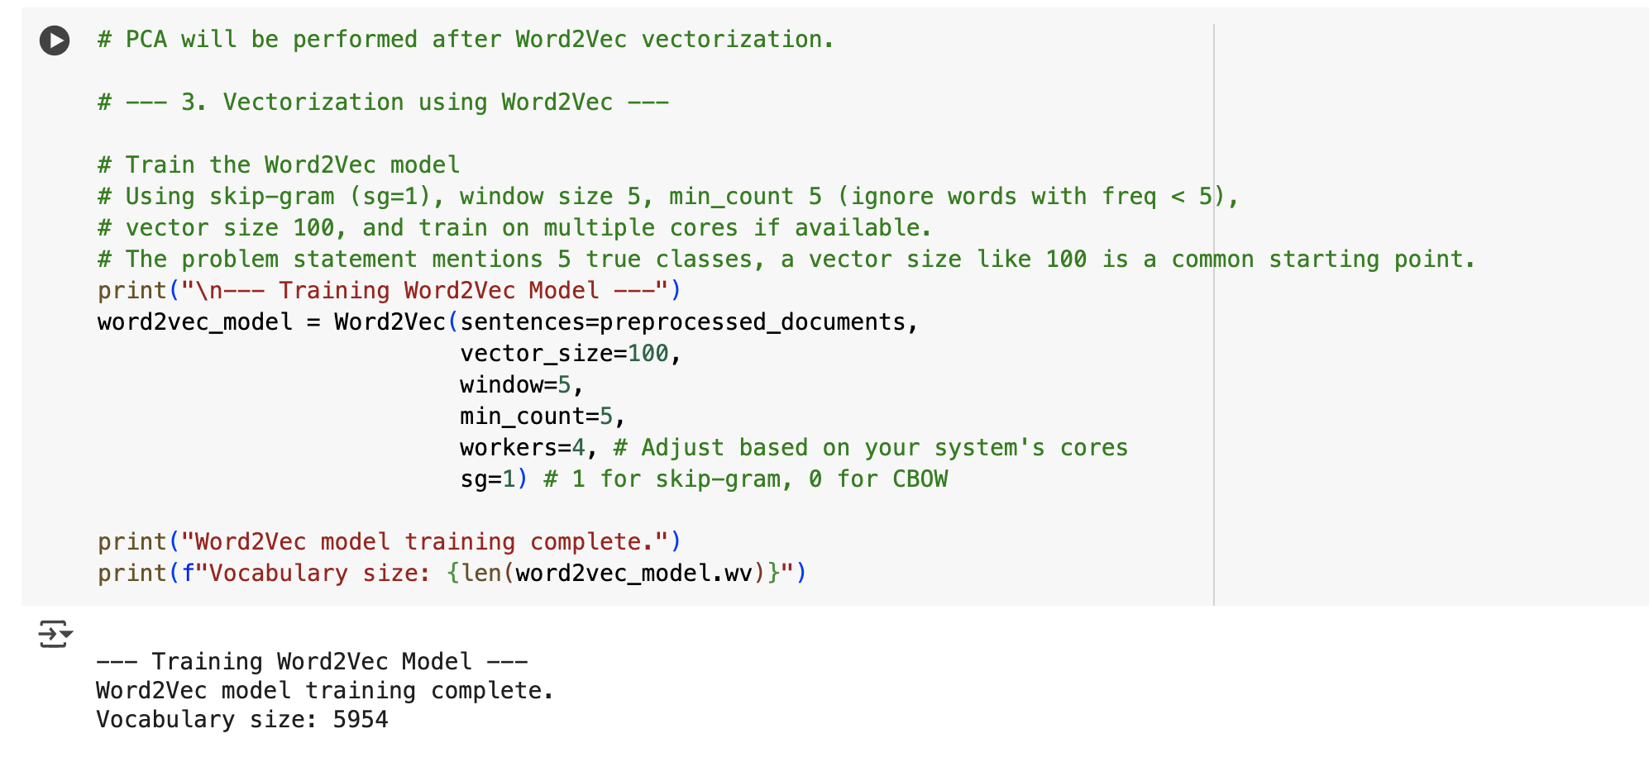
Word2Vec
Word2Vec maps words to dense vectors based on context in large corpora .
It could be used for obtaining word similarity, sentiment analysis, embeddings for deep models
It converts words into continuous vector representations that capture semantic meaning and relationships.
Based on the above mentioned features of Word2Vec , the generated vectors help us in further steps of clustering and classification .

Slide 13
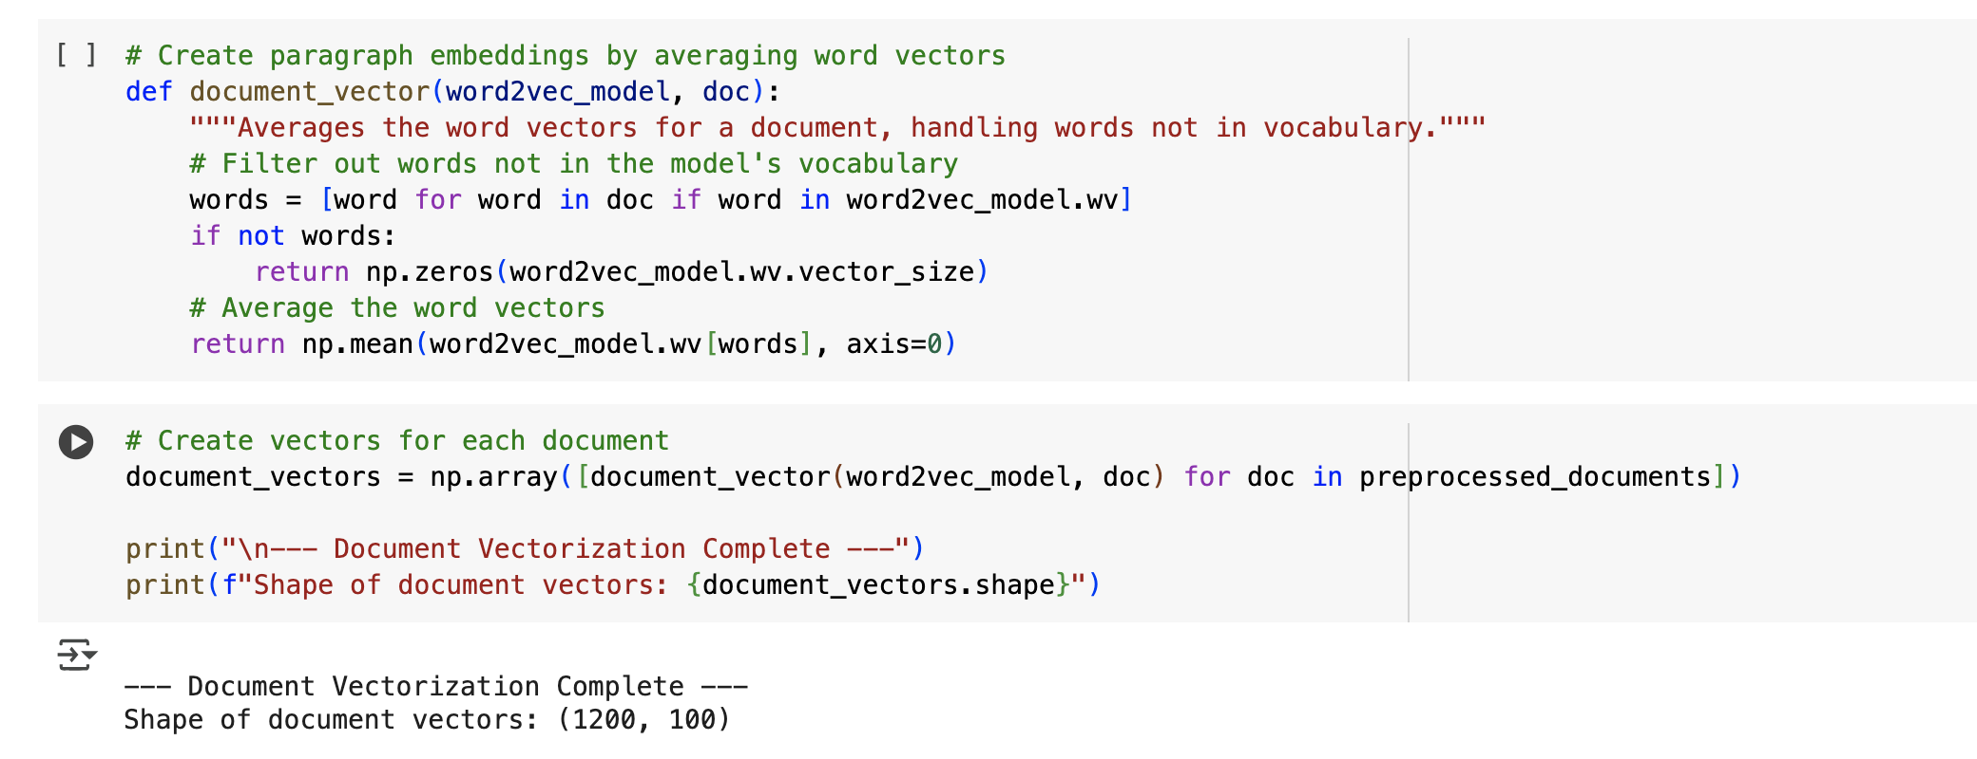
Word2Vec cont...
To perform the vectorization of the tokenized words, word2vec function was used which converts the words in the preprocessed documents into vectors
The vector size of each word vector is 100.
The output of the word2vec function are the document vectors, which need to be converted to the NumPy array for analysis.
The total of 1200 documents (training dataset) were analyzed .

Slide 14
Principal Component Analysis(PCA)
PCA is used for -
Reducing dimensionality: If the data set has many different measurements , PCA aims to find a smaller number of new, artificial variables (called principal components) that still capture most of the variance in the original data.
Identifying important patterns: These principal components are created in a way that the first one explains the most variability in your data, the second explains the next most, and so on. By looking at these components, you can figure out which underlying factors or directions in your data are the most significant. It's like finding the strongest trends in a complex dataset.

Slide 15
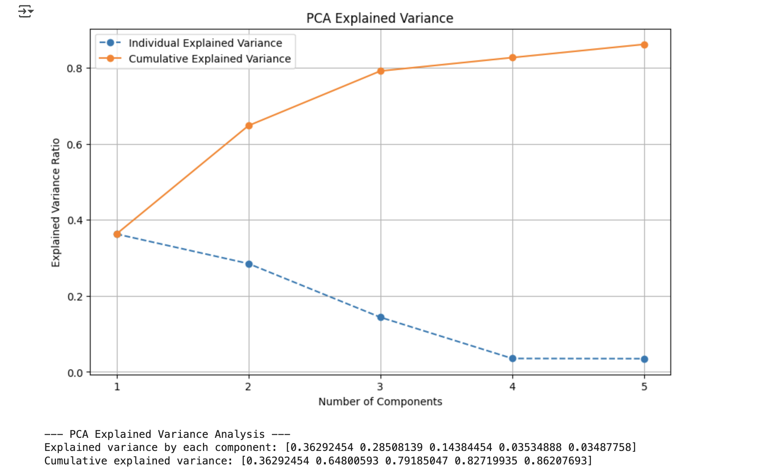
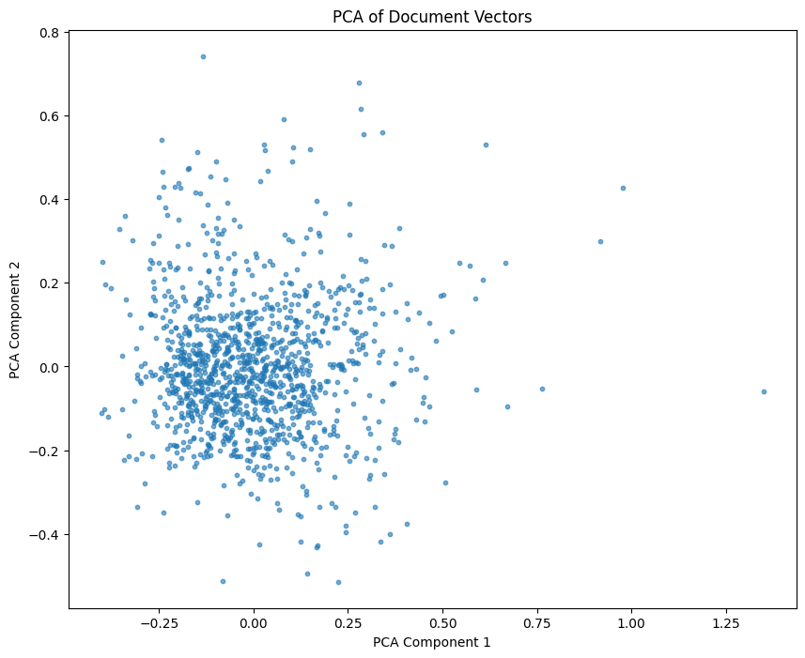
Principal Component Analysis
The principal component analysis is performed on the document vectors, where the number of components per vector have been reduced to 5 elements.
PCA as seen above is dimension reduction technique. The shape of the reduced PCA vector is (1200 , 5). The total variability of data explained by the PCA components can be seen in the below graph.

Slide 16
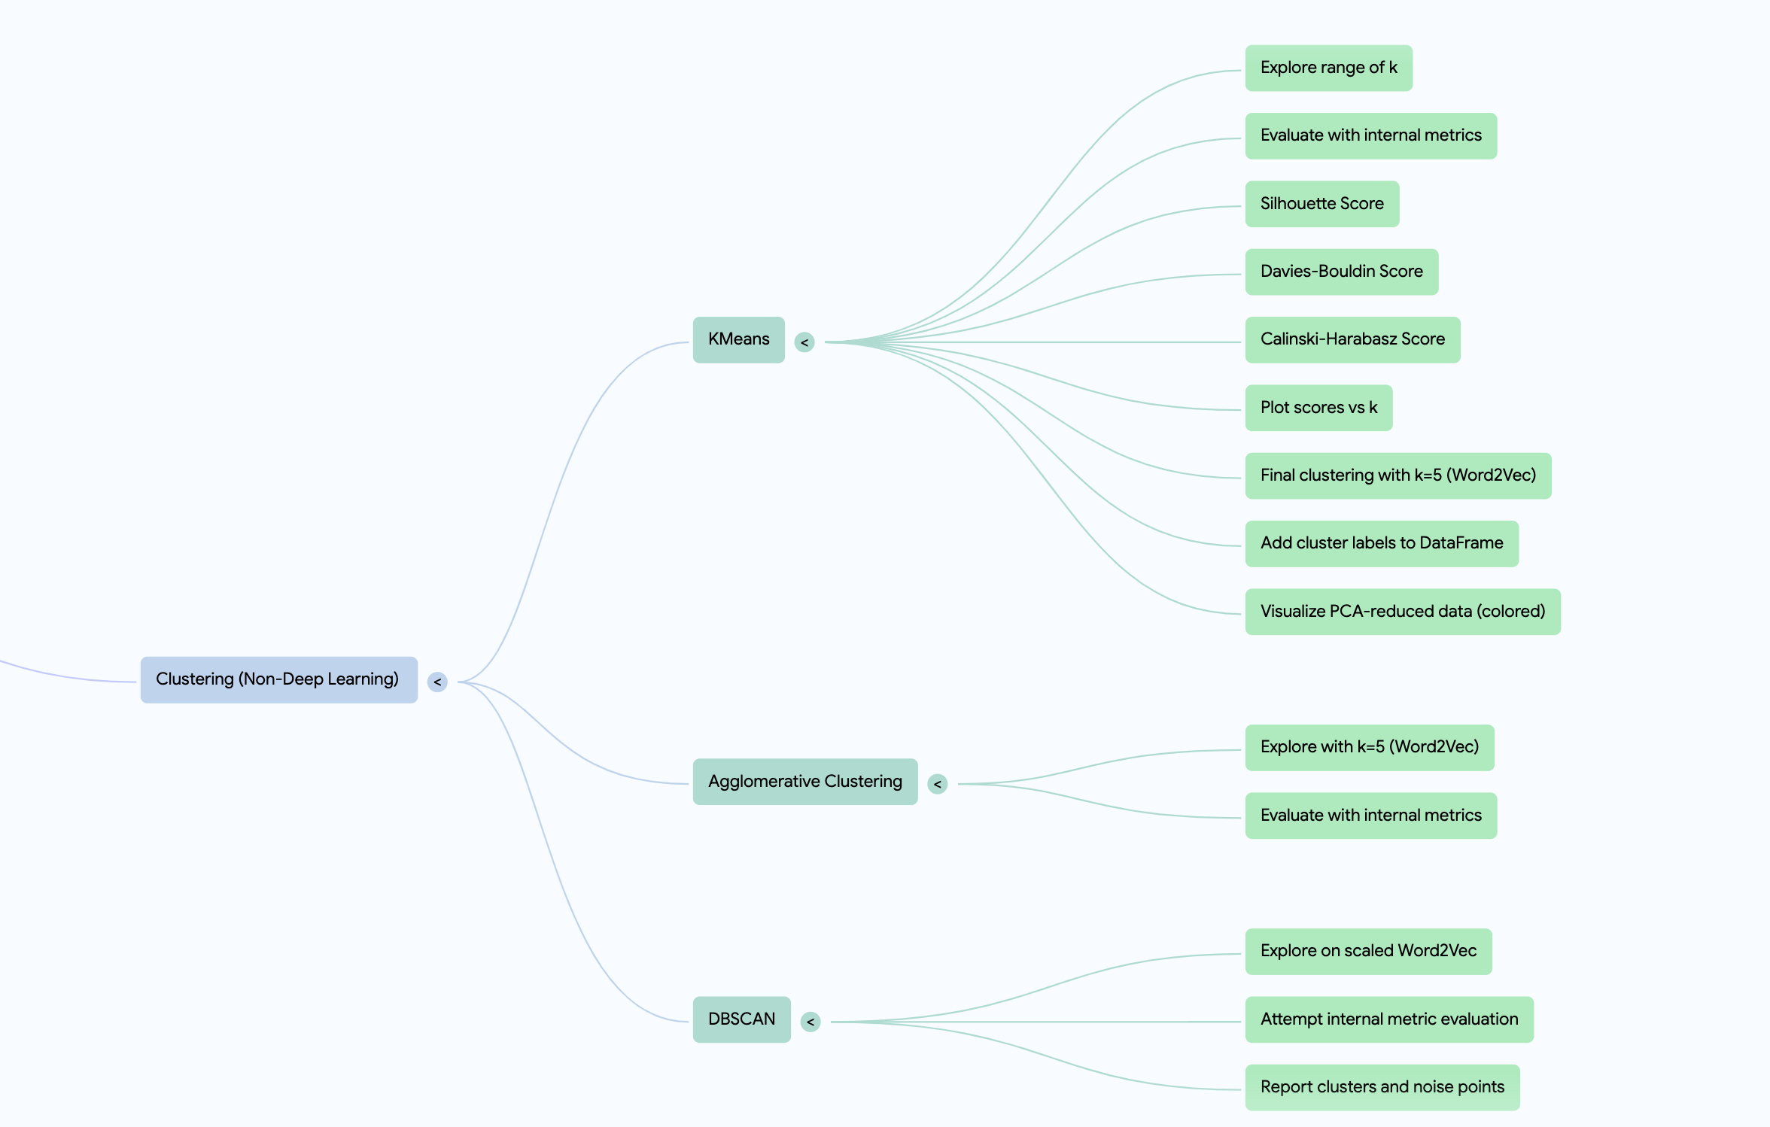
Clustering Mind map

Slide 17
Clustering Approaches
DBSCAN (Density-Based Spatial Clustering of Applications with Noise) is an unsupervised clustering algorithm that groups points based on density, making it effective for detecting outliers and discovering clusters of arbitrary shape.
K-Means clustering is a centroid-based algorithm that partitions data into ( k ) clusters by minimizing the variance within each cluster. It iteratively assigns points to the nearest centroid and updates centroids until convergence, making it efficient but sensitive to initialization and outliers
Agglomerative clustering is a hierarchical clustering method that starts with individual data points as separate clusters and iteratively merges the closest clusters based on a linkage criterion until a stopping condition is met.

Slide 18
Clustering Steps
The initial approach taken for clustering was the k means (n==5). It was also compared with DBSCAN and Agglomerative clustering .
The choice of cluster centres were decided basis the principal component analysis, where 5 PC’s explained majority of variance in the data
The input document vectors used for clustering were obtained post the principal component analysis, there are labelled as document_vectors_pca. These are vectors obtained from the word2vec algorithm and PCA was performed on them to reduce dimensions.
To understand the efficiency of the approach the silhouette score, DB score and Calinski harabasz score were computed.
As per the given problem statement, the results of 5 clusters were considered, and they had the silhouette score of 0.2275.
For the comparison purposes the silhouette score of clustering for the TF-IDF vector and word2vec were compared, where the word2vec performed better.

Slide 19
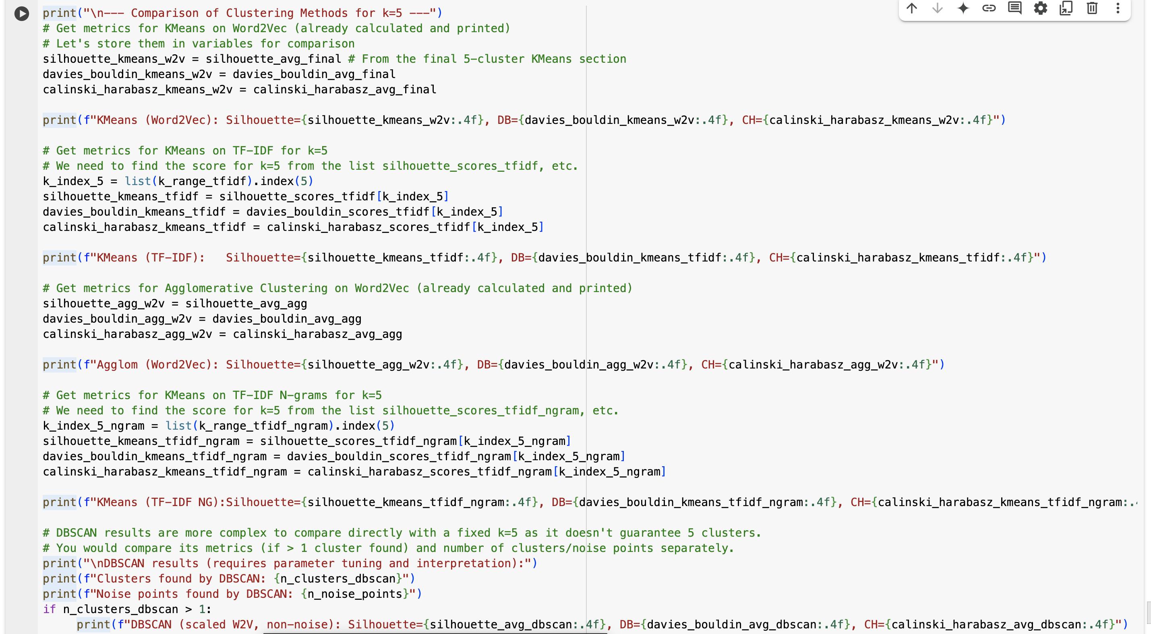
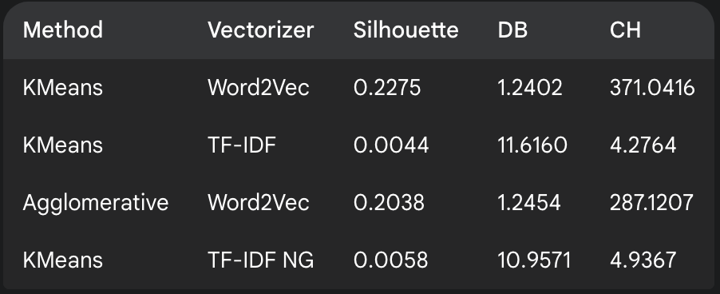
Clustering Implementation & Results
As seen from the results Kmeans on word2vec vectors outperforms all other methods

Slide 20
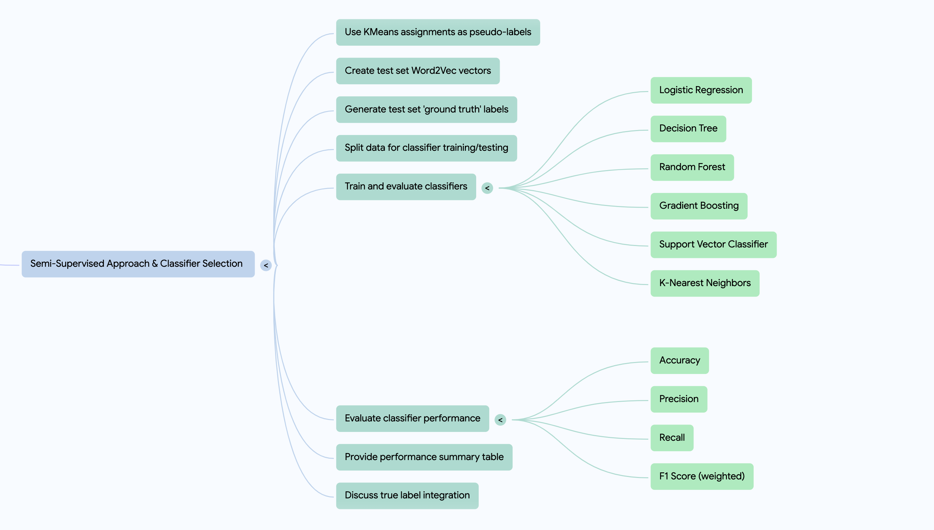
Classification Mind map

Slide 21
Different Classification Algorithms
Logistic regression is a supervised learning algorithm used for binary classification, predicting probabilities using the logistic (sigmoid) function. It estimates weights through optimization techniques like gradient descent, making it interpretable and effective for linear decision boundaries .
Random Forest is an ensemble learning algorithm that builds multiple decision trees during training and merges their predictions for improved accuracy and robustness. It reduces overfitting by averaging results, making it effective for both classification and regression tasks
Support Vector Machine (SVM) is a supervised learning algorithm that guides to separate data points into distinct classes while maximizing the margin between them. It works well for both linear and non-linear classification using kernel tricks to handle complex decision boundaries.
Gradient Boosting is an ensemble learning technique that builds models sequentially, where each new model corrects the errors of the previous one by minimizing a loss function. It leverages weak learners (typically decision trees) and improves performance through weighted adjustments, making it powerful but prone to overfitting without tuning
A Decision Tree is a supervised learning algorithm that splits data into branches based on feature conditions, forming a tree-like structure for classification or regression. It follows a series of decision rules, making it intuitive and interpretable but prone to overfitting without pruning

Slide 22
Classification Steps
The dataset considered is the document_list_train.
For the classification algorithm we define the X and y (target) variables where X are the document vectors and Y are the pseudo labels. The pseudo labels come from k means clustering .
The variables X and Y are partitioned using train_test_split function. The algorithms used for classification are logistic regression, decision tree, random forest, gradient boosting etc.
These algorithms are evaluated basis metrics such as precision, recall, f1 score and accuracy value, where the best performing algorithms is Random Forest (comparison results attached in next slide ).
The results are validated on the testing dataset (document_list_test) as well, and the results of these dataset is similar to the training one, hence it can be concluded that the classification algorithms perform well.

Slide 23
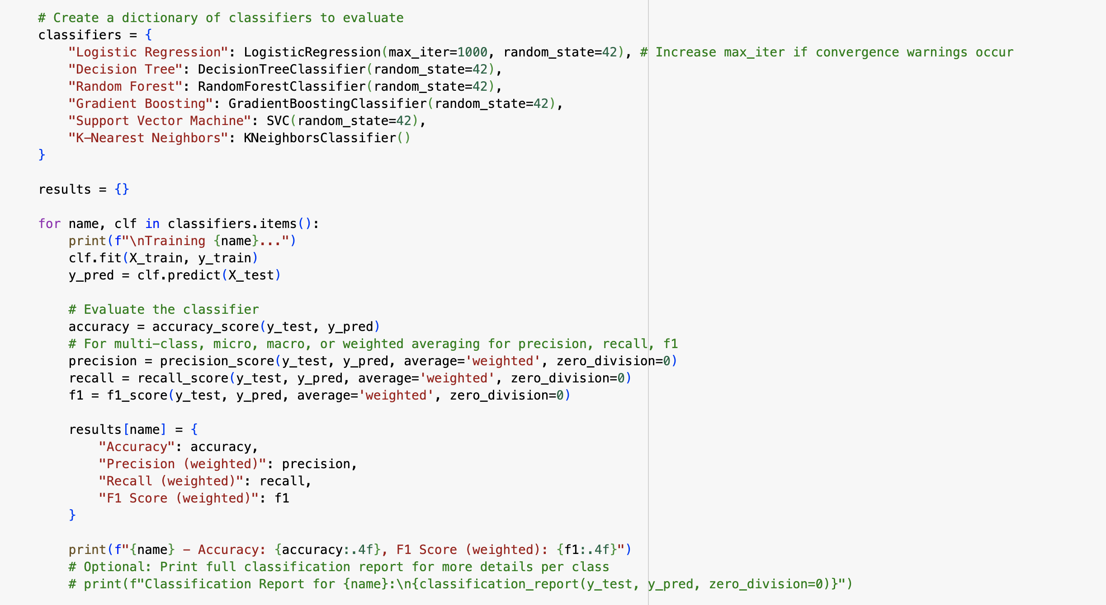
Classification Implementation

Slide 24
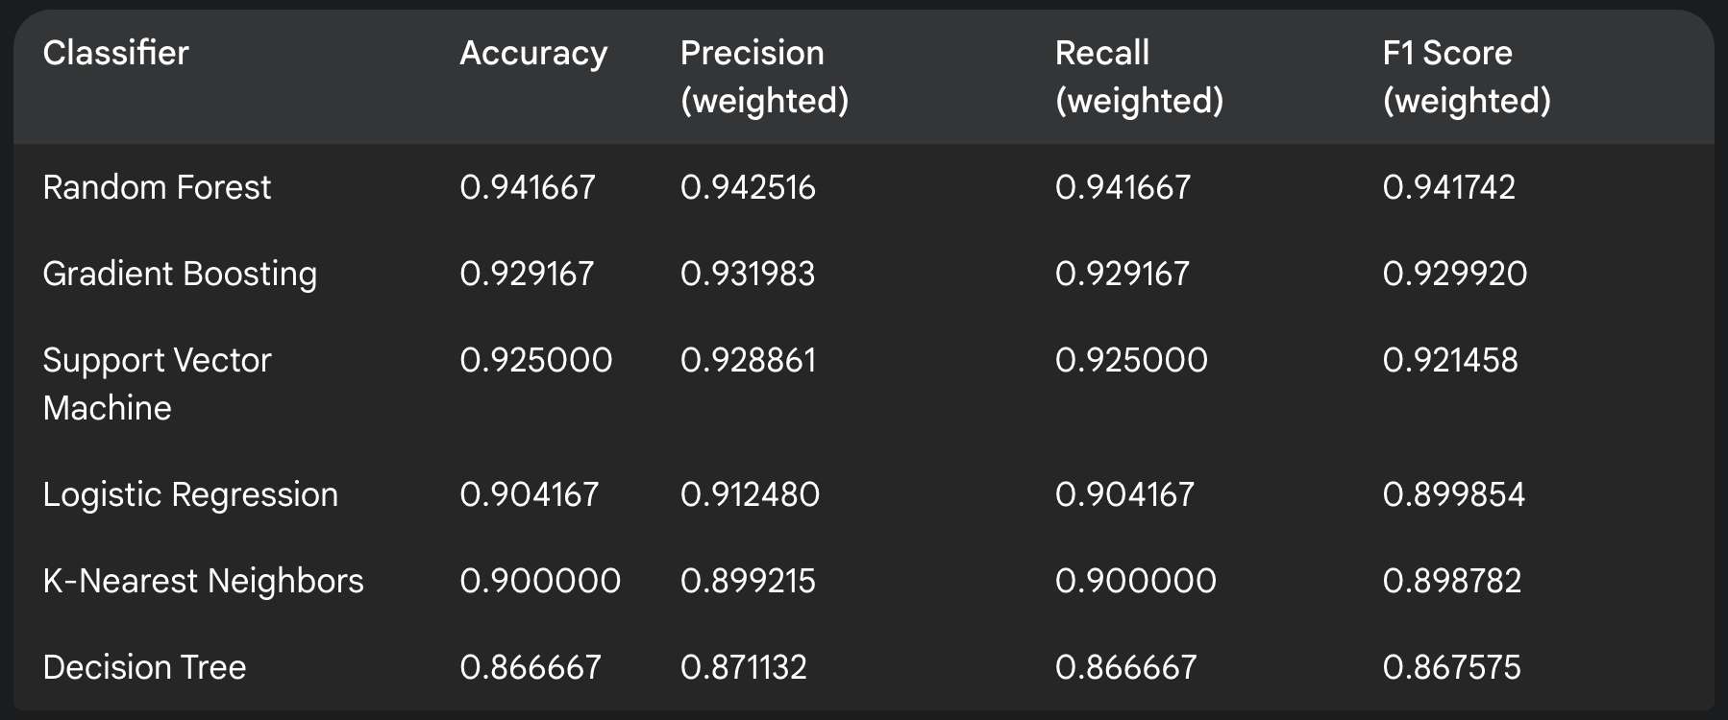
Classification Results

Slide 25
Challenges
The absence of labels in datasets poses a significant hurdle for the classification
of text documents.
Selecting the most effective text vectorization method (e.g., Word2Vec vs. TF-IDF) is context-dependent and impacts cluster quality.
The choice of clustering isn't an obvious choice, had to be decided basis comparative analysis
Assessing clustering "correctness" without true labels is difficult; internal metrics only reflect structural quality, not semantic accuracy.
Evaluating classifiers on pseudo-labels measures prediction of cluster structure, does not necessarily align with the true underlying classes.
Algorithms used for classification and clustering have been computationally intensive .

Slide 26
Learnings
Word embeddings perform better than word encodings for the text data ,
hence , Word2Vec has been preferred over TF-IDF vectorization approach .
Exploratory Data Analysis, including document statistics and embedding visualizations (PCA, t-SNE), offers valuable understanding of data characteristics.
Trying different algorithms (KMeans, Agglomerative, DBSCAN) expose varied inherent structures and groupings within the document set.
Using cluster outputs as pseudo-labels effectively leverages large unlabelled datasets for training classifiers.
Unsupervised and semi-supervised tasks benefit greatly from an iterative approach of exploration & parameter tuning.

Slide 27
Conclusion
Successfully implemented an end-to-end pipeline: data loading, robust pre-processing, diverse vectorization (Word2Vec, TF-IDF), and multiple clustering approaches.
Demonstrated a practical semi-supervised learning strategy by training classifiers on cluster-derived pseudo-labels, effectively utilizing unlabelled data.
Internal evaluation metrics proved crucial in navigating unsupervised clustering choices, highlighting the impact of algorithms, vectorization, and cluster counts.
The optimal solution involves an effective combination of vectorization, clustering, and classification techniques .

Slide 28
Image Processing

Slide 29
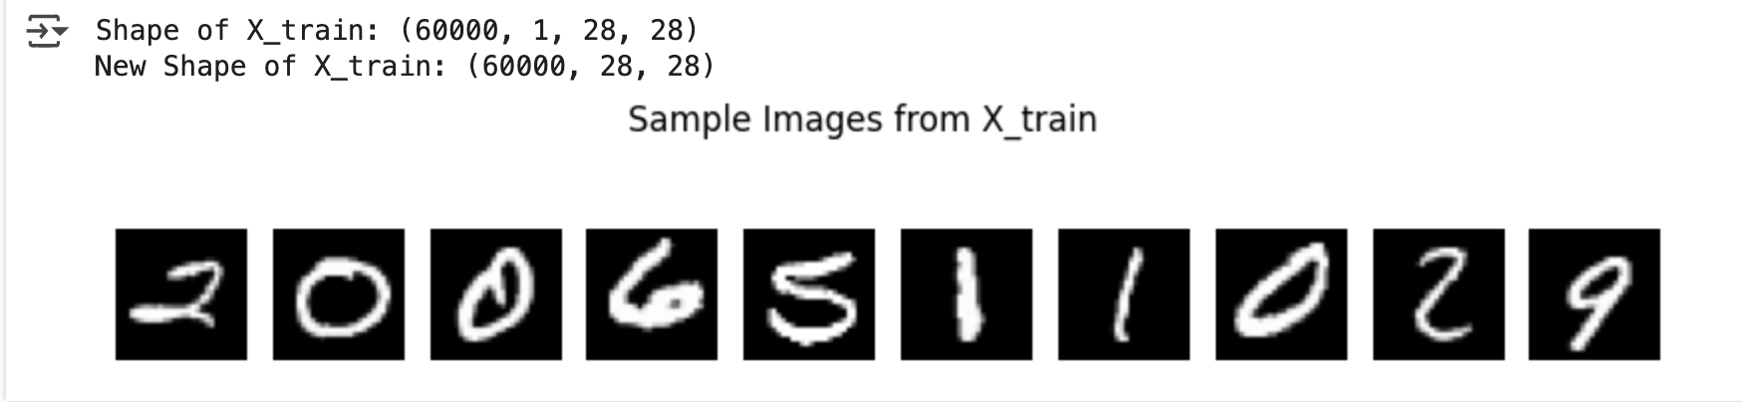
Introduction & Data Set
OBSERVATIONS :
The dataset contains a Numpy array of shape (60000, 1, 28, 28)
Shape of X_train: (60000, 1, 28, 28)
Sample 10 images from the dataset

Slide 30
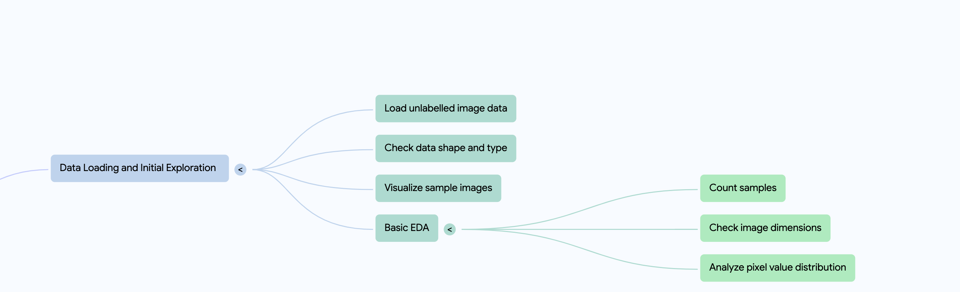
Initial Data Exploration Mind map

Slide 31
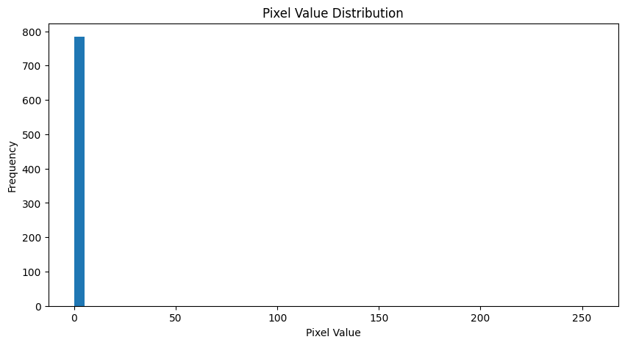
Single Image Analysis
In the below graph we can see the x-axis represents the range of pixel values from 0 to 255 .
The y-axis represents frequency of pixels
The data values are normalized as they range between 0 and 1.
Stats :
Mean pixel value is 0.13
Std deviation is 0.31

Slide 32
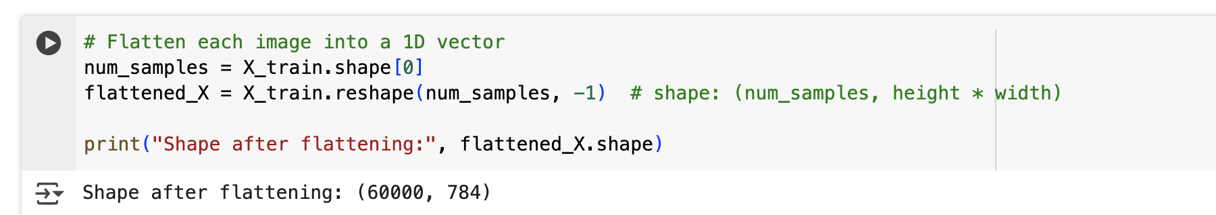
Data Preprocessing
Reshaping and Flattening : We flattened the images to convert from 2D image data to a 1D vector
The machine learning algorithms used for clustering and classification expect vectors as an input .
Shape after flattening was (60000, 784)

Slide 33
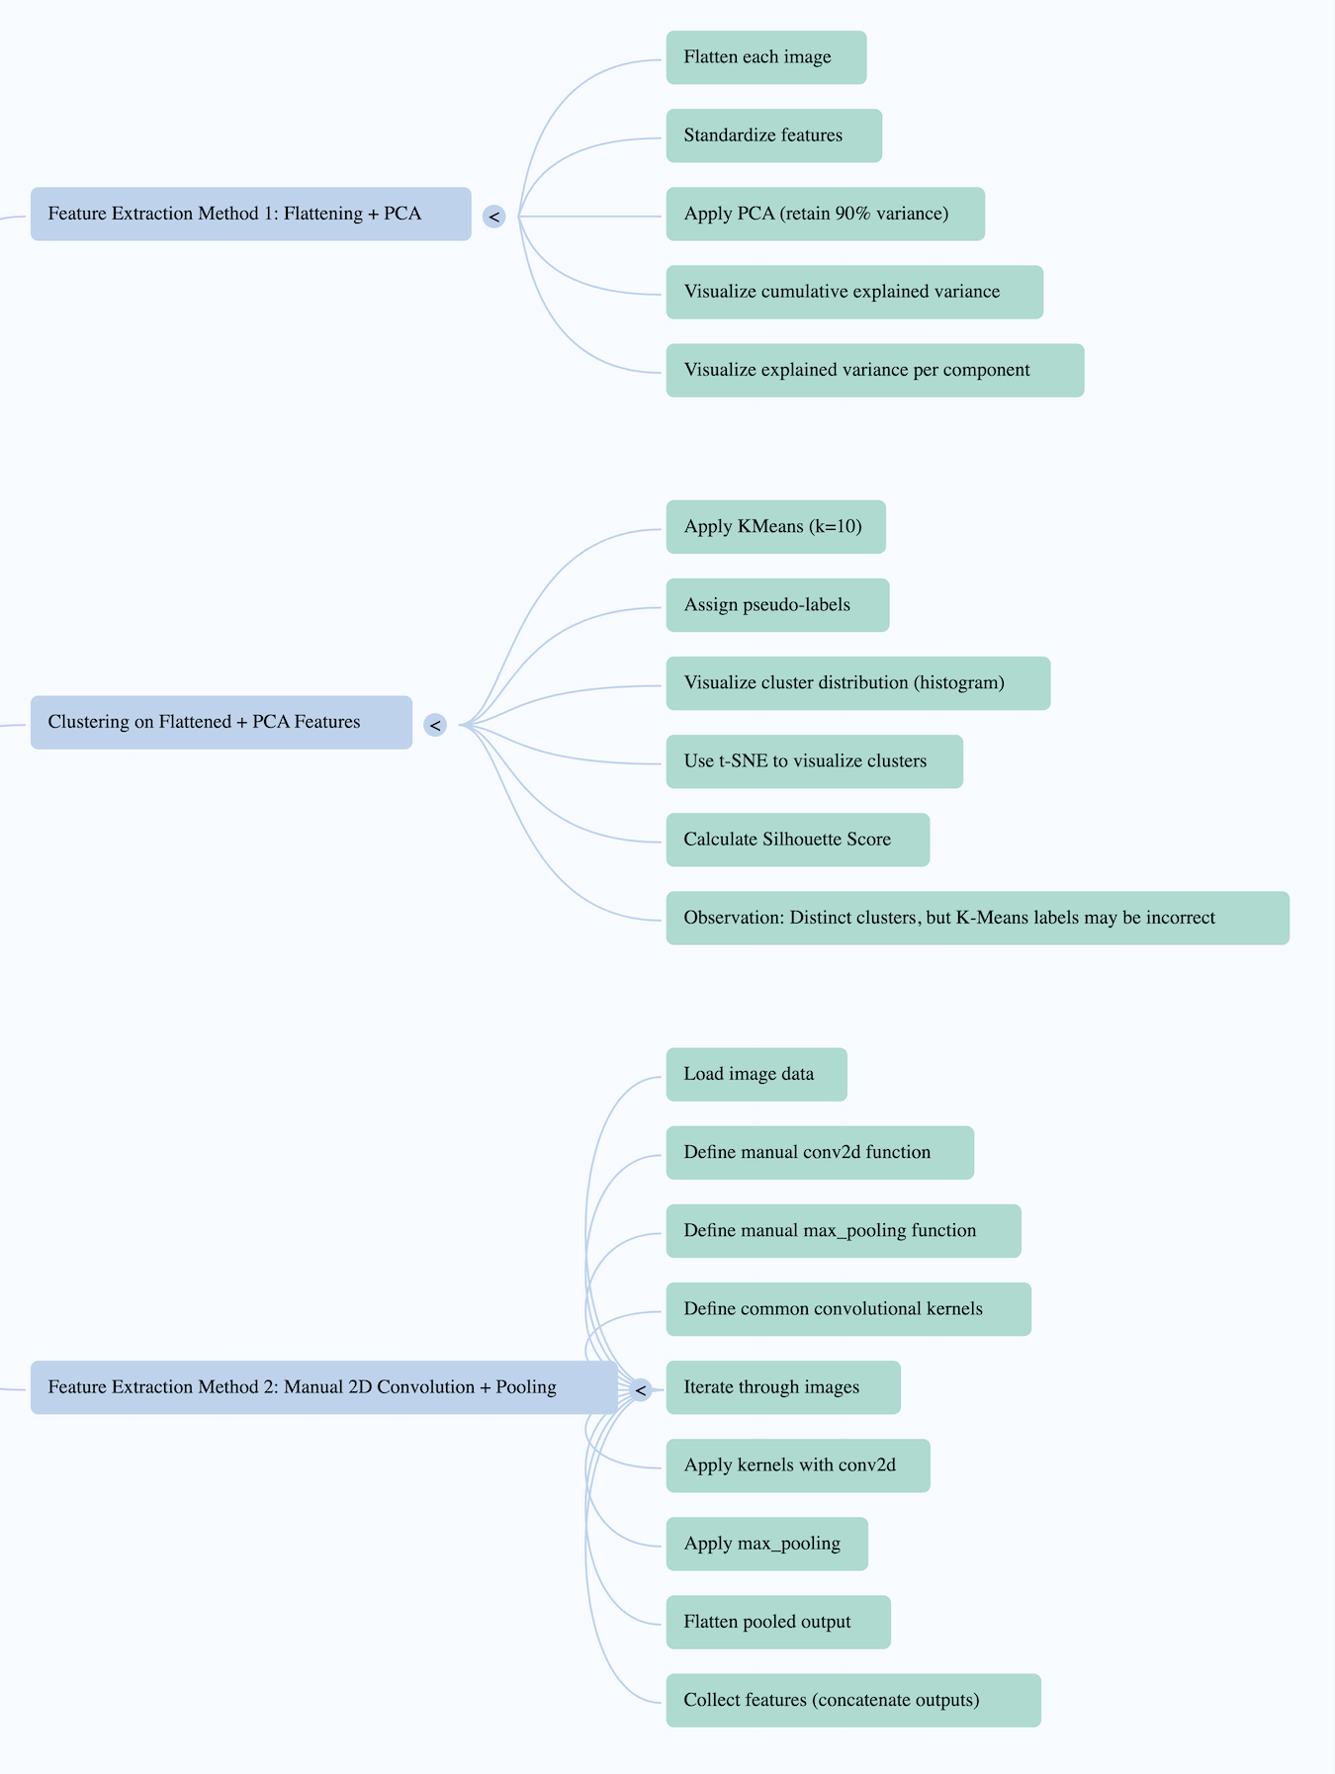
Approaches
For Image Feature extraction , clustering and classification , we have tried following approaches :
Feature extraction
using flattening and PCA
Clustering on flattened data with PCA Features
Feature extraction using 2D
Convolution and Pooling

Slide 34
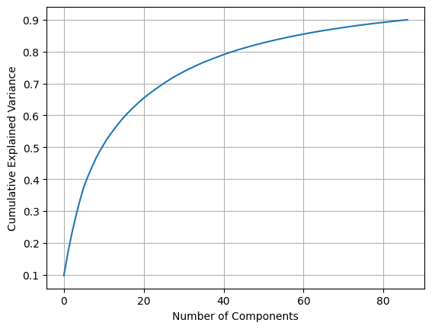
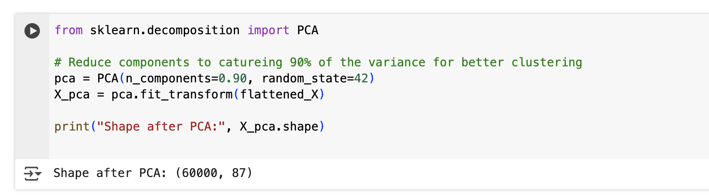
Approach 1
PCA (Principal Component Analysis )
We have performed PCA on the flattened vector data to reduce dimensions and capture maximum variance.
PCA helps improve clustering quality by denoising and reducing redundancy.
The total number of dimensions reduced from 784 to 87 post PCA .

Slide 35
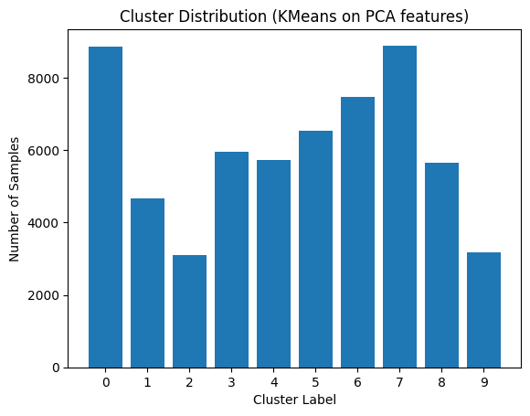
Approach 1 : Clustering
The graph here represents K Means Clustering on PCA Features
Since the dataset contains handwritten images from 0 to 9 we can say that there are 10 clusters in our dataset.
Our objective here to group similar images together and generate pseudo-labels for the unlabeled image data.
The bar chart displays the number of
samples in each cluster .
.

Slide 36
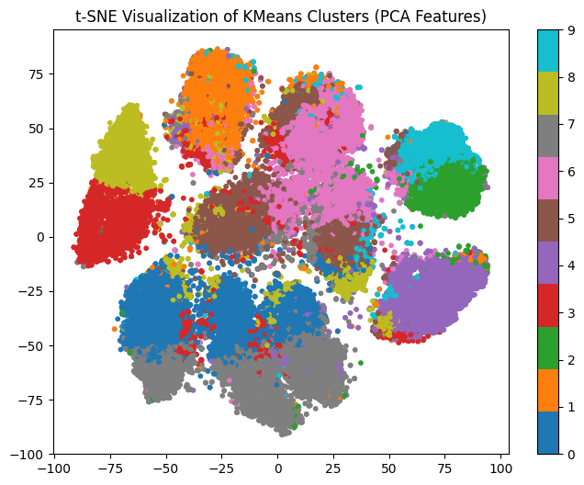
Approach 1 : t-SNE Visualization
t-SNE (t-distributed Stochastic Neighbor Embedding): It is a dimensionality reduction technique primarily used for visualizing high-dimensional datasets in low-dimensional space (typically 2D or 3D).
We have applied t-SNE Visualization on the PCA components. The different colours represent 10 distinct clusters, showing their relative separation and grouping in this reduced dimensional space .
With this method we obtained a Silhouette Score: 0.0725 which can be significantly improved, hence other approaches have been considered .

Slide 37
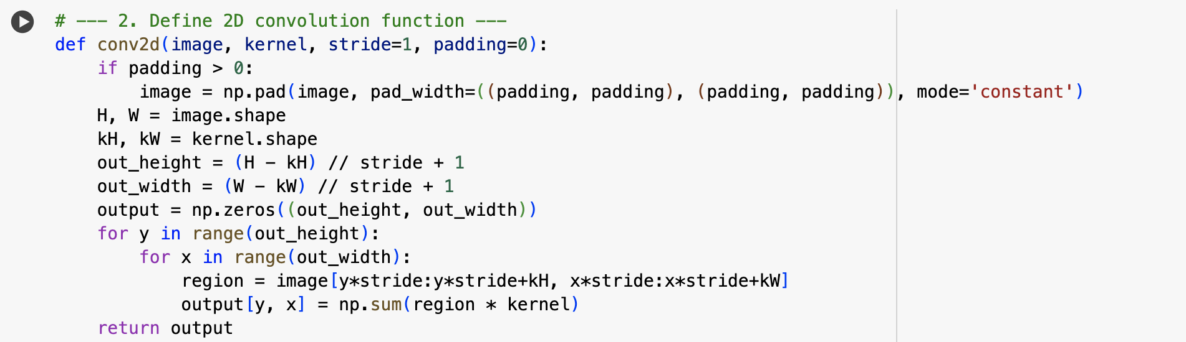
Approach 2
In the second approach we have used 2D Convolution technique.
2D Convolution: It's a fundamental image processing technique where a small matrix (kernel or filter) slides across a 2D input (like an image), performing element-wise multiplication and summation at each location to produce a transformed output that highlights specific image features (like edges, textures, or blurs) based on the kernel's values.

Slide 38
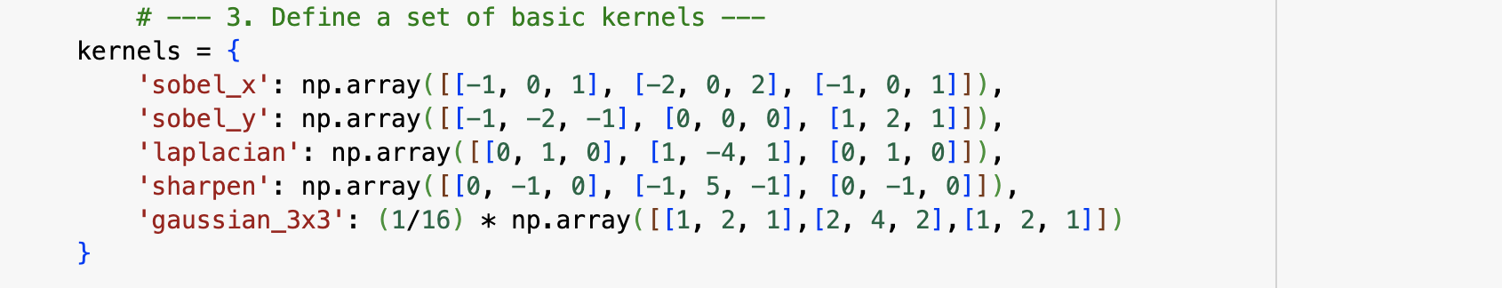
Approach 2 : Convolution 2D
A kernel is a small matrix (or function) that acts as a filter, sliding across an input (like an image or data) to perform a specific operation through element-wise multiplication and summation, ultimately extracting features, modifying the input, or measuring similarity based on the kernel's defined pattern or weights.
For this approach we have define below Kernels - ‘sobel_x', 'sobel_y', 'laplacian', 'sharpen', 'gaussian_3x3'.
Each kernel identifies a specific pattern in the image.

Slide 39
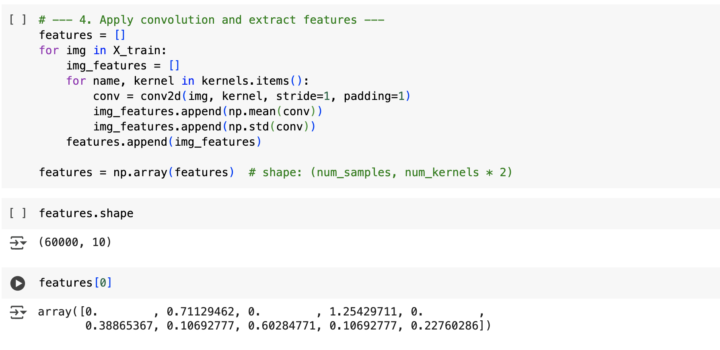
Approach 2 :Applying Convolution
Finally have applied convolution that extracts features from images using convolutional filters (like edge detectors) and summarizes each result using statistical values.
By running the above function we can see the below output .
For each kernel we take the mean and standard deviation and save it so that we get the following shape : (num_samples, num_kernels * 2)

Slide 40
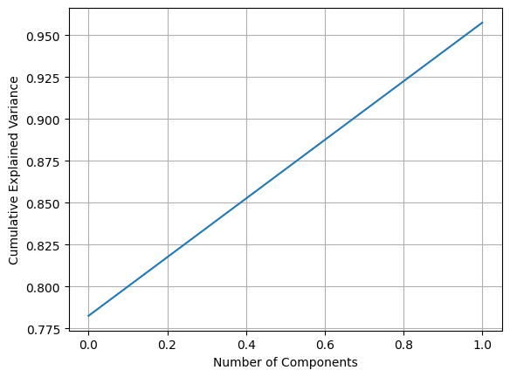
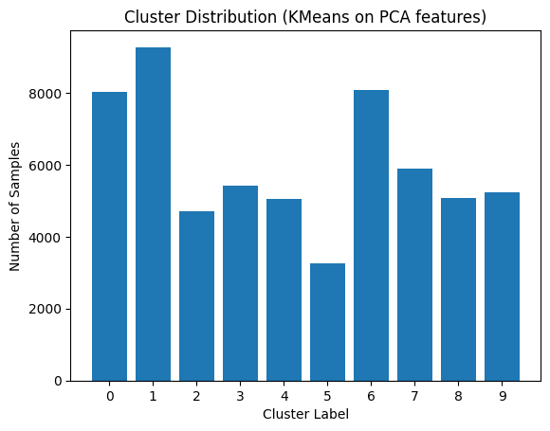
Approach 2 : PCA & Clustering
We perform PCA for dimensionality reduction and can see that with 2 components we can capture 95% of the variance.
We perform K means on these PCA components to get the below cluster distribution.

Slide 41
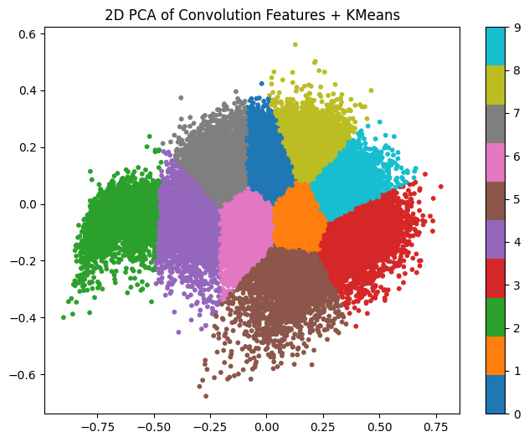
Approach 2 : KMeans + PCA Results
Below is the graph shows the result of applying PCA for dimensionality reduction and K-Means clustering on features extracted from images using convolutional filters.
Silhouette Score: 0.3373

Slide 42
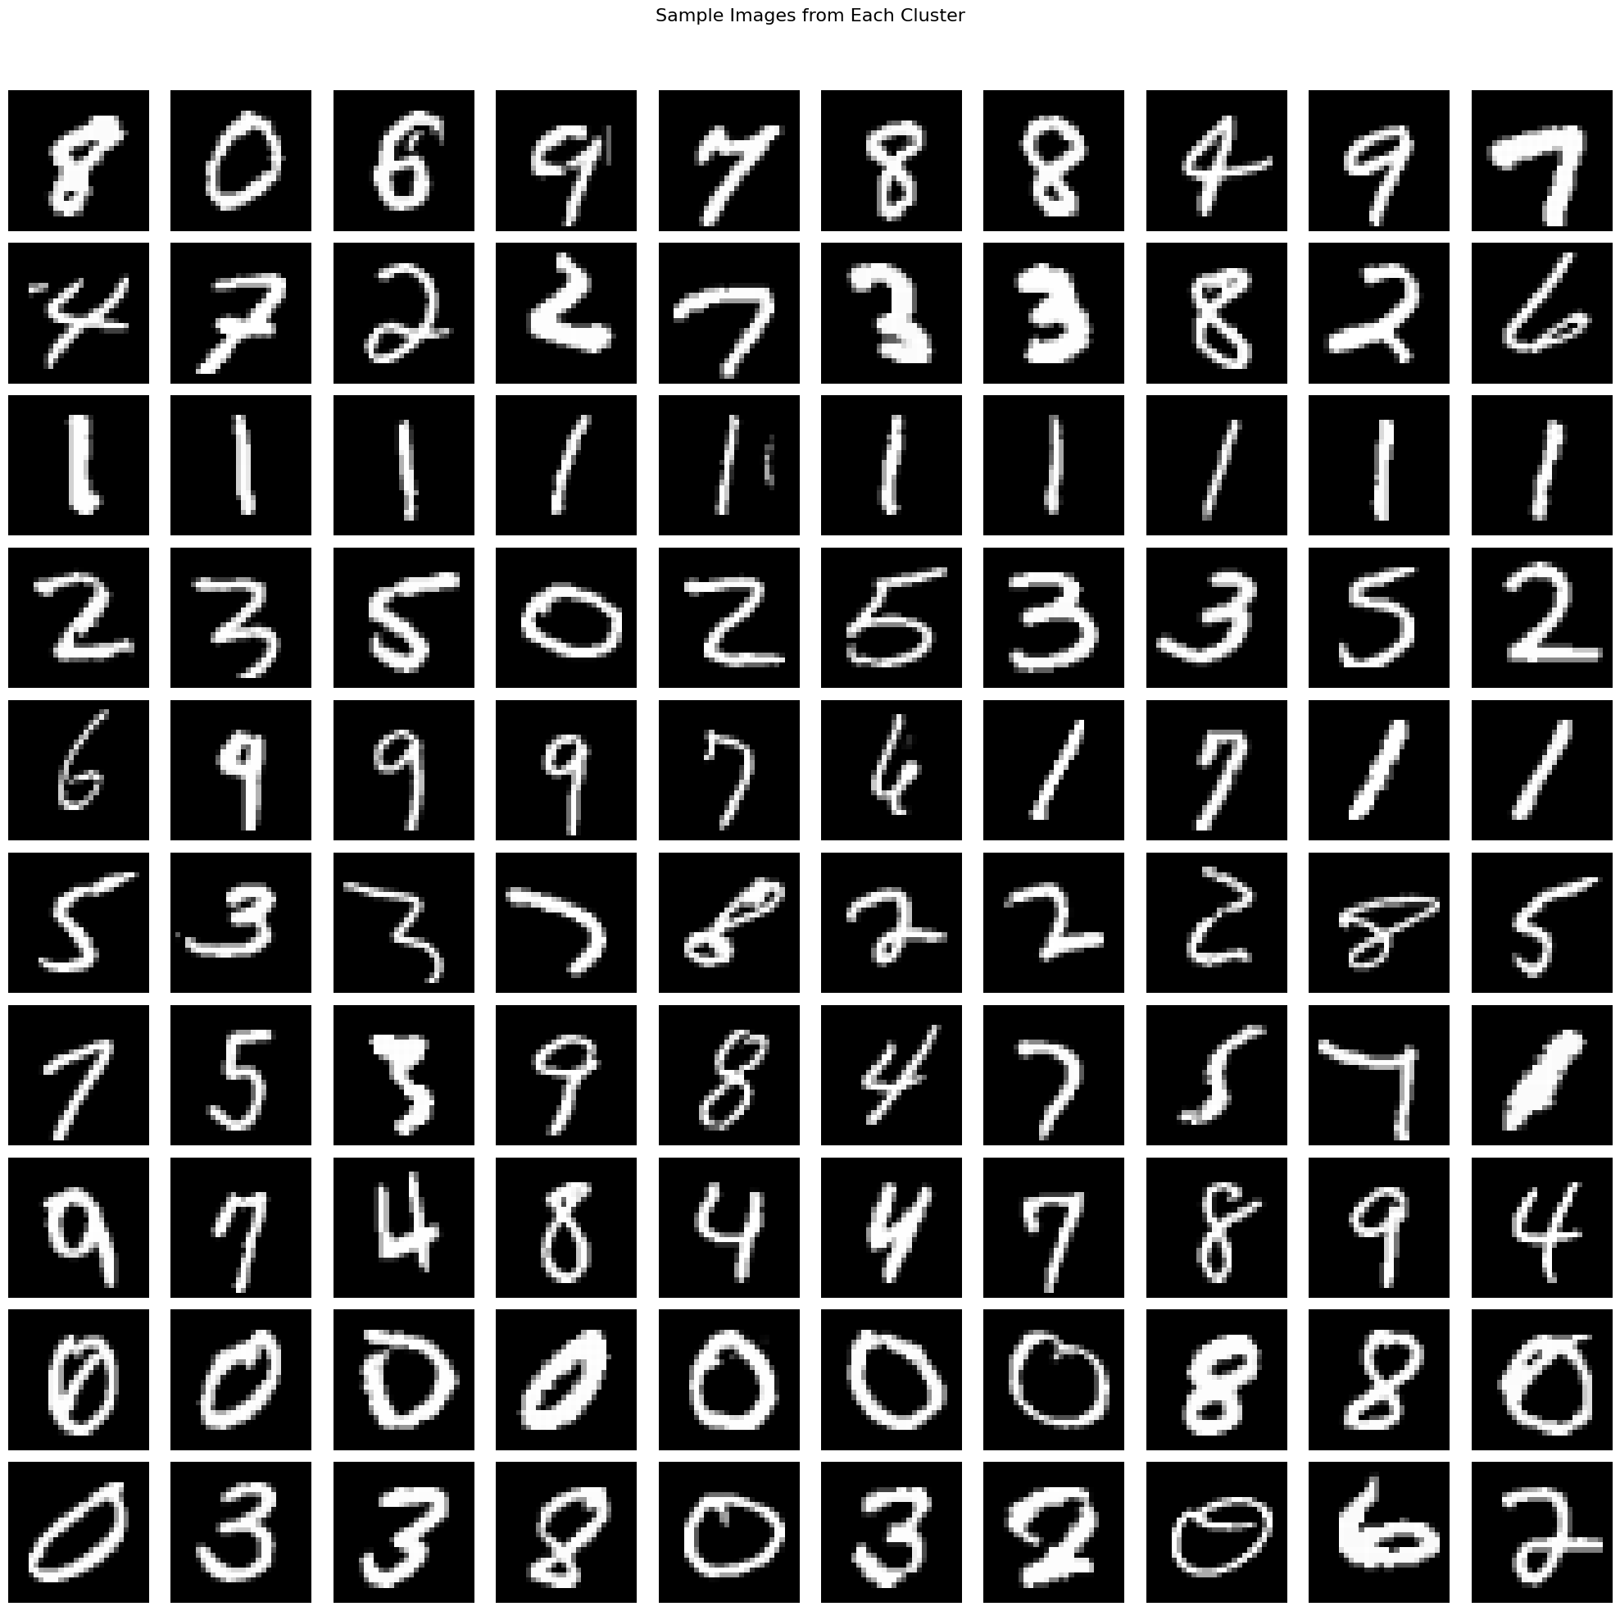
Approach 2 : Kmeans Clustering Results
Below are the row wise display of sample Images from Each Cluster

Slide 43
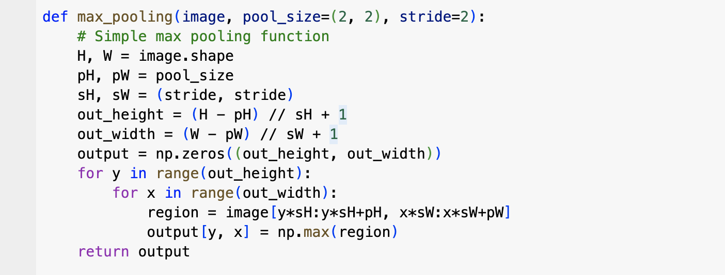
Approach 3
Finally we have tried to use 2D Convolution technique along with max pooling to improve the clustering results.
Maxpooling is a down sampling operation commonly used in convolutional neural networks that reduces the spatial dimensions (width and height) of a feature map by dividing it into small rectangular blocks and outputting the maximum value within each block, thereby making the representation more robust to small translations and distortions while also decreasing computational cost
In our case , we use the predefined 2D convolution function along with the Kernels mentioned above.
Additionally, we also define a max pooling function as can be seen in the snap.

Slide 44
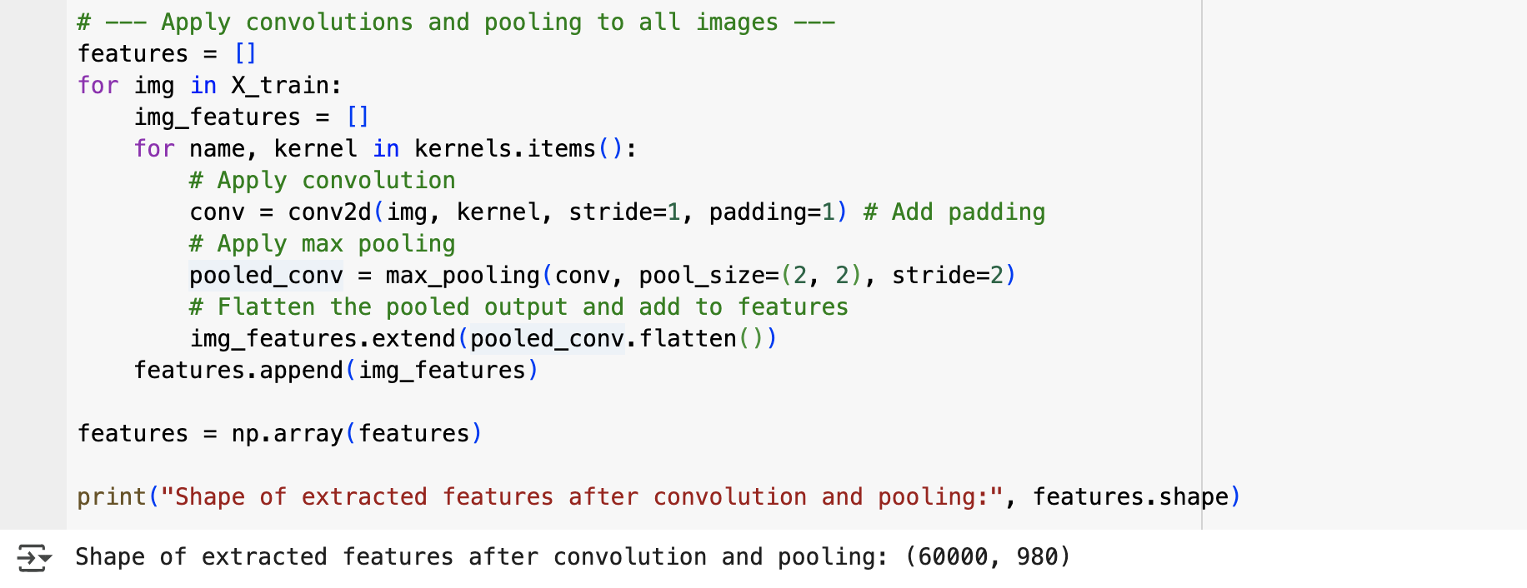
Approach 3 : Applying Max Pooling
Now we apply convolutions and pooling to all images and save the features.
Shape of extracted features after convolution and pooling: (60000, 980)

Slide 45
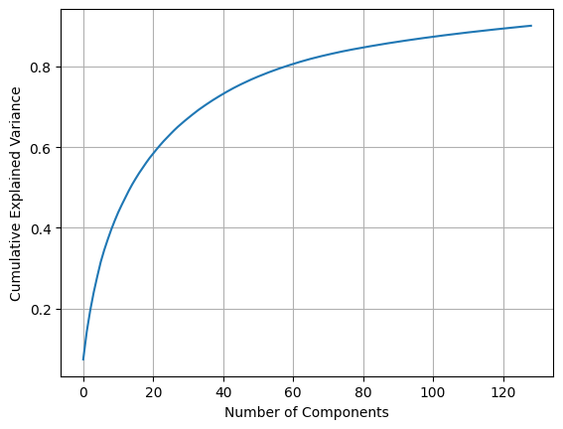
Approach 3 : Principal Component Analysis (PCA)
We have plotted a graph to calculate Cumulative Explained Variance per Number of PCA Components. From the graph we can know that approximately 130 components are needed to capture 90% of the variance.

Slide 46
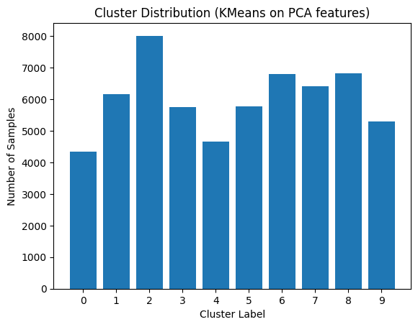
Approach 3:Clustering on PCA
K Means Clustering has been performed on PCA Features
Since the dataset contains handwritten images from 0 to 9 we can clearly say that there are 10 clusters in our dataset.
Our objective here to group similar images together and generate pseudo-labels for the unlabeled image data.
We can see the cluster distribution from
the attached snap .
Here we can see that by implementing
max pooling along with 2D convolution
we get a better cluster distribution.

Slide 47
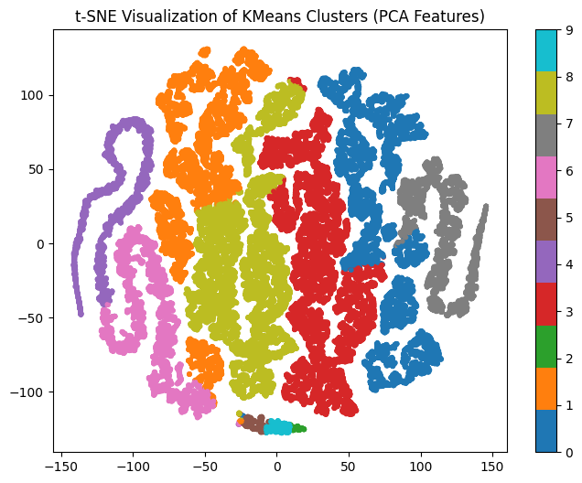
Approach 3 : t-SNE Visualization
We have applied t-SNE Visualization on the PCA components. With this method we can see a Silhouette Score: 0.0792

Slide 48
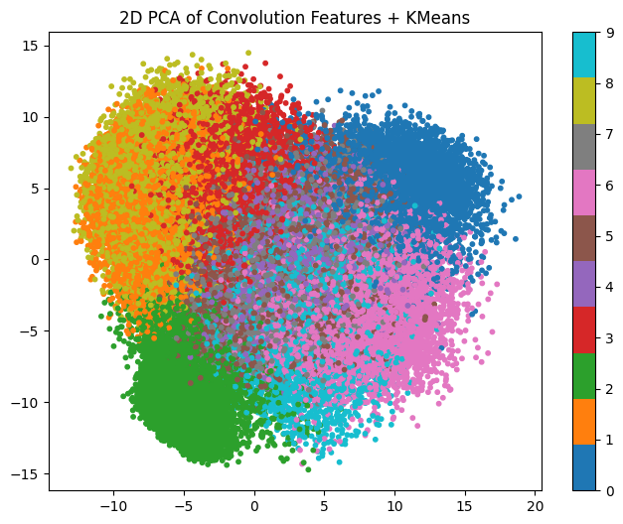
Approach 3 : Clustering + PCA Results
Here we can see the 2D PCA of Convolution Features + KMeans

Slide 49
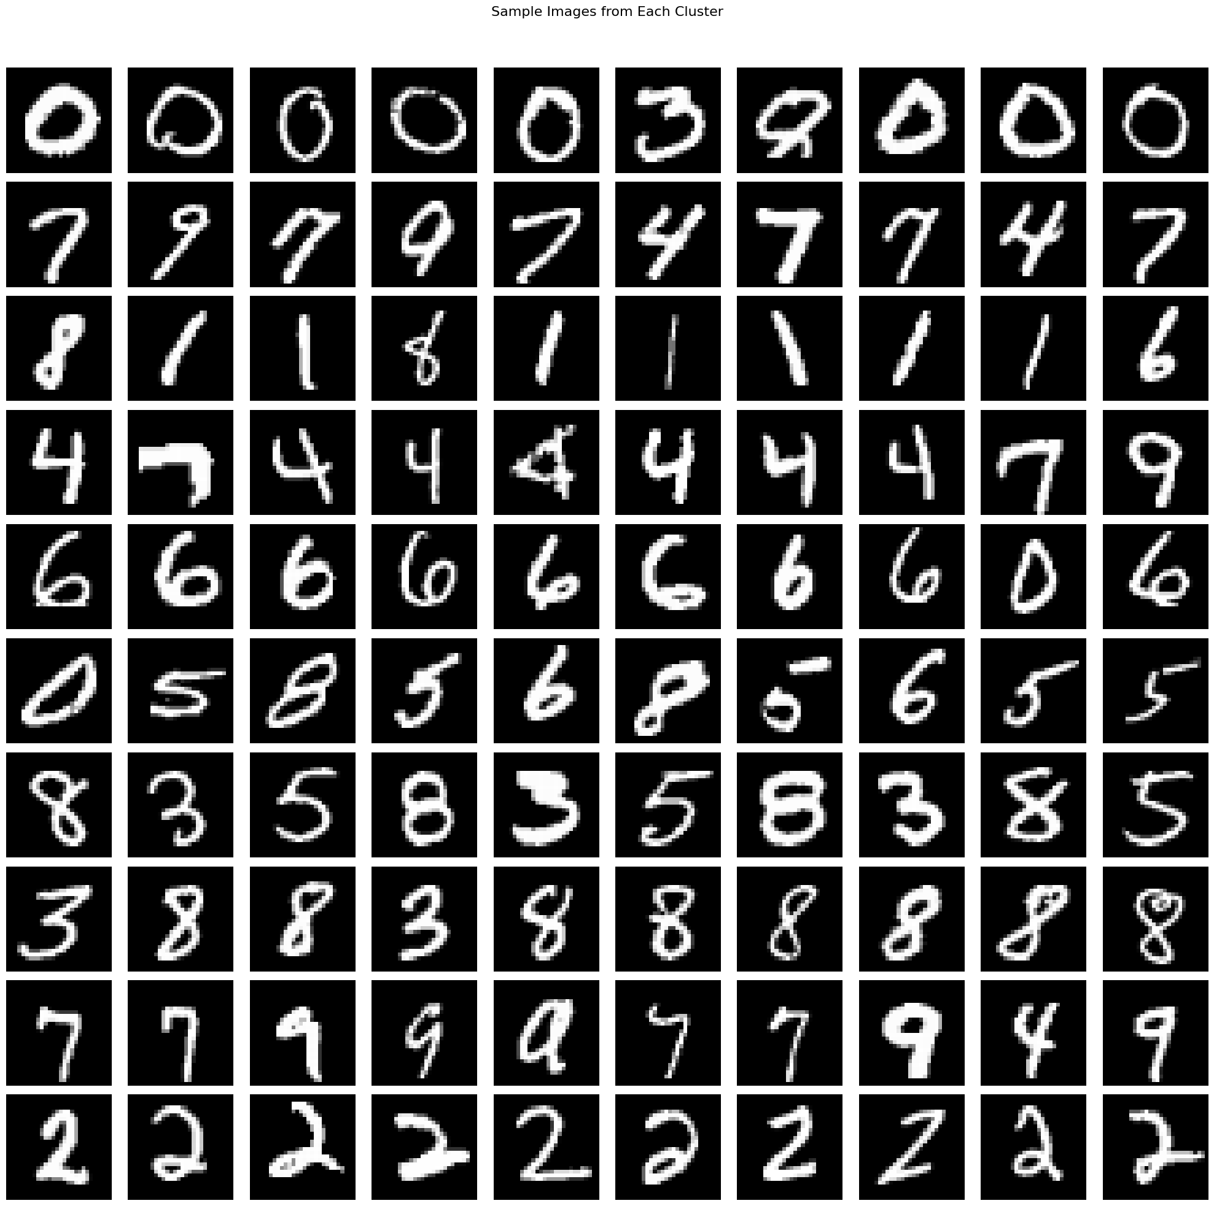
Approach 3 : Clustering Results
Here we can see the sample Images from Each Cluster from our K means interpretation

Slide 50
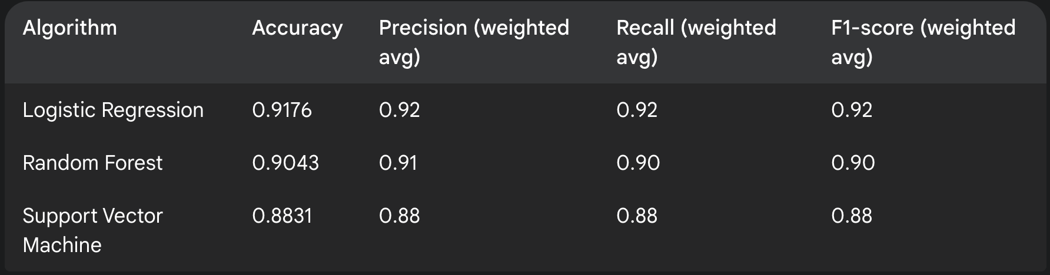
Approach 3 : Applying Classification on Clustered Data Set
Based on the results and the generated labels obtained from clustering , we will try a semi-supervised approach of training classifiers .
Three classifiers were evaluated on a test set of 12,000 samples . Below are the performance metrices :
Looking into below table , logistic regression seems to be outperforming the rest.

Slide 51
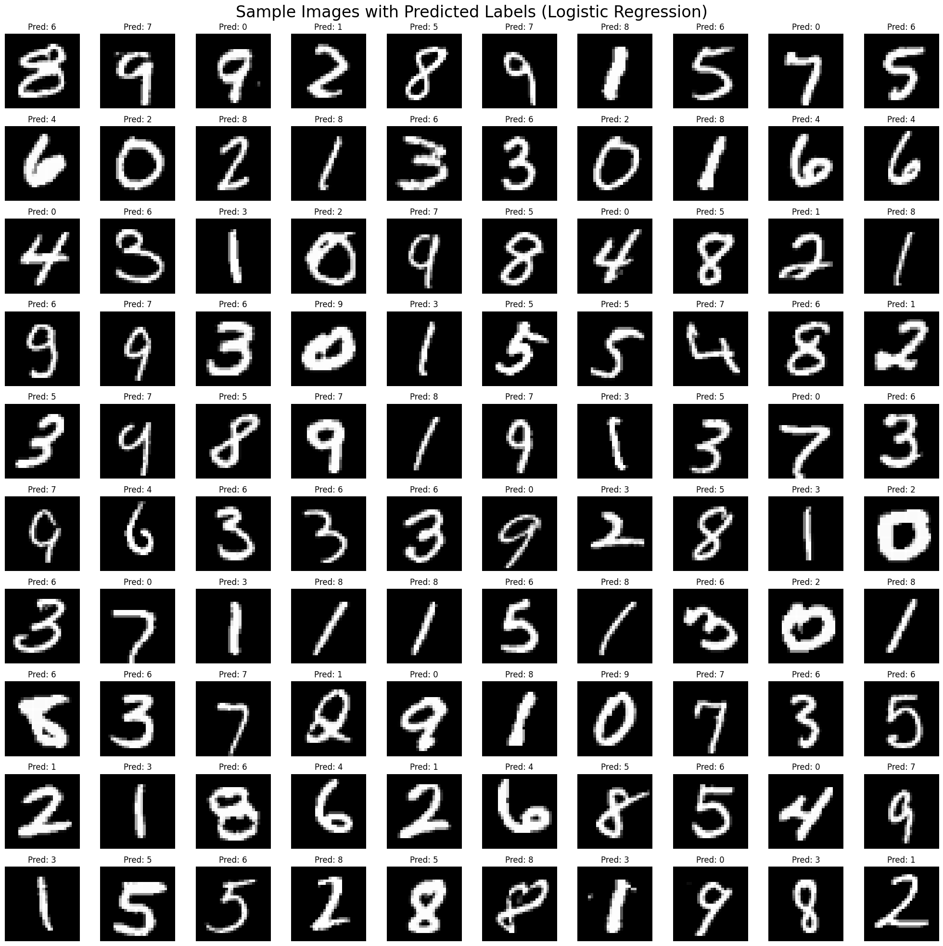
Approach 3 :Classification Results
Here we can see the sample Images from Each Cluster from our K means interpretation with the respective label mentioned after classification .

Slide 52
Challenges
Clustering algorithms (K-Means, DBSCAN) struggled to create clearly distinct groups from complex, high-dimensional image data.
Raw pixel data and standard PCA projections failed to provide sufficient semantic structure for effective image clustering.
Selecting the optimal convolution filters and accurately interpreting their impact on feature extraction proved difficult.
Manual feature engineering using convolution filters (e.g., Sobel, Laplacian) was a necessary but complex undertaking but still didn’t give optimum results , so max-pooling was considered .
While apparent features provided some initial structure, they were frequently insufficient for achieving clear unsupervised cluster separation.

Slide 53
Learnings
Essential data pre-processing, including standardization and dimensionality reduction (like PCA), is crucial for model stability and efficient convergence.
Feature engineering, even with basic filters, reveal valuable spatial patterns in images, offering insights without relying on deep learning.
Unsupervised model performance is inherently challenging to quantify without labelled data, as visual ambiguity may not correlate with numerical cluster quality.
For considered images , raw pixels or simple PCA often lack the rich semantic information required for meaningful clustering.

Slide 54
Conclusion
Successfully implemented an end-to-end pipeline: image data loading, image flattening , image filtering using kernels (‘sobel_x', 'sobel_y', 'laplacian', 'sharpen', 'gaussian_3x3’), clustering & classification .
Demonstrated a practical semi-supervised learning strategy by training classifiers on cluster-derived pseudo-labels, effectively utilizing unlabelled data.
Internal evaluation metrics proved crucial in navigating unsupervised clustering choices, highlighting the impact of algorithms, vectorization, and cluster counts.
The optimal solution involves an effective combination of pre-processing , vectorization , clustering, and classification techniques .

Slide 55
References
Notebooks
Text Processing
Python Notebook : EPGD_SEM1_TEXT_PROCESSSING.ipynb
Image Processing
Python Notebook : EPGD_SEM1_IMAGE_PROCESSING.ipynb

Slide 56


